Slide 1

Flight Delay Prediction Using Machine Learning and Deep Learning
Group 11
1 | Rutvi Agrawal
2 | Praveen Kumar
3 | Kushagra Saurabh
4 | Malhar Bhatt
5 | Balaji Srinivasan

Slide 2
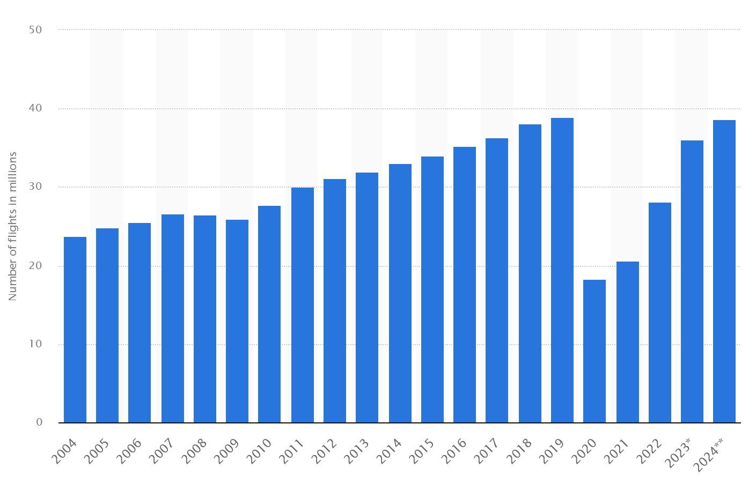
Why Flight Delay Prediction ?
Predicting flight delays is critical for improving airline operations, enhancing passenger satisfaction, and optimizing air traffic management. This project focuses on building a machine learning (ML) and deep learning (DNN) pipeline to predict flight delays (in minutes) based on various flight characteristics such as departure time, distance, carrier, and weather conditions.
The solution processes over a million rows of raw flight data, incorporates feature engineering, trains multiple models, and deploys the best-performing model via a containerized REST API. Tools such as Docker, Postman, a lightweight web server, and a Python cron job were used to automate and operationalize the pipeline.

Slide 3
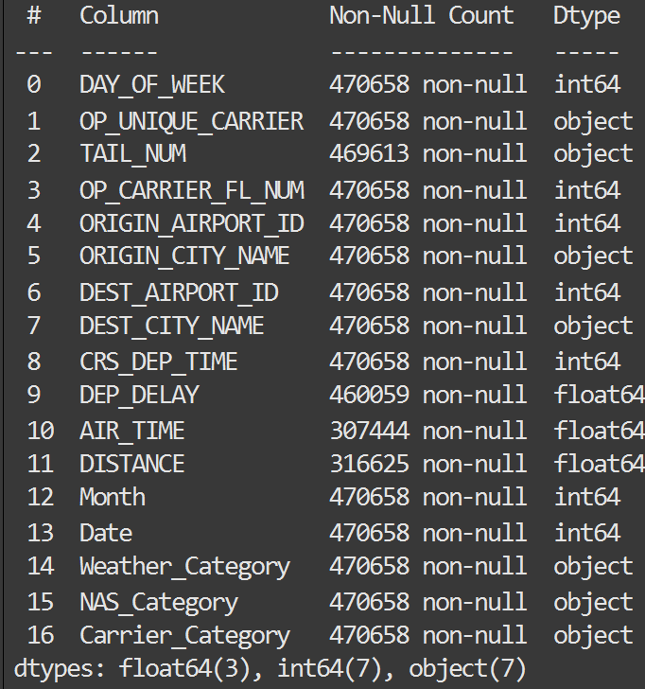
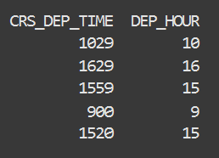
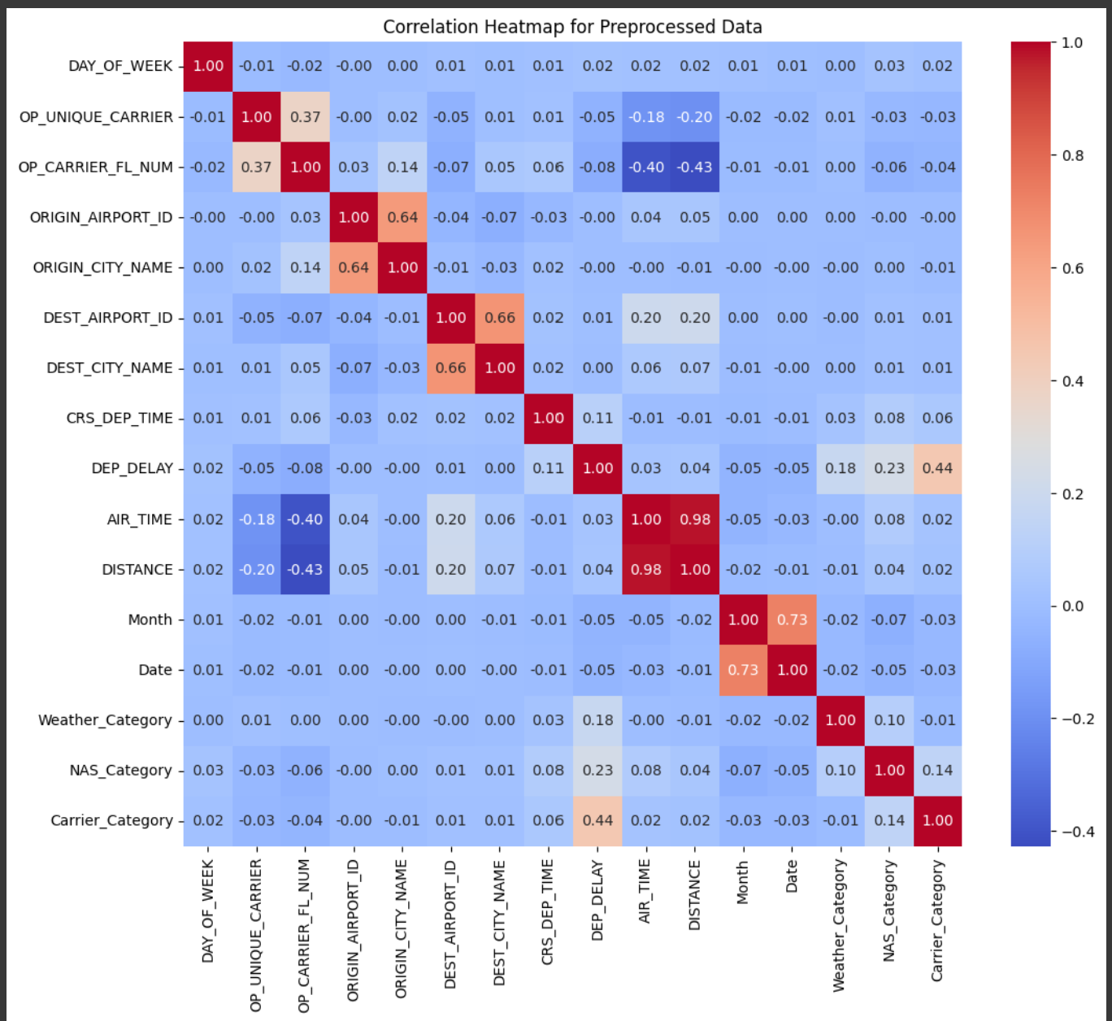
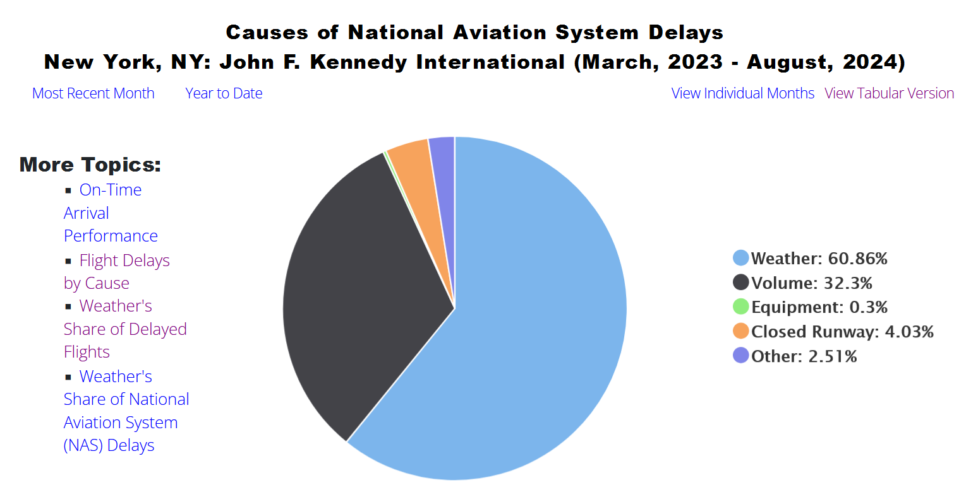
Data set info and Data Clean up performed
1 | YEAR | 2023
2 | DAY_OF_WEEK | 01-Jul
3 | FL_DATE | 06-05-2023 0.00
4 | OP_UNIQUE_CARRIER | 9E
5 | TAIL_NUM | N133EV
6 | OP_CARRIER_FL_NUM | 5064
7 | ORIGIN_AIRPORT_ID | 14685
8 | ORIGIN_CITY_NAME | Savannah, GA
9 | DEST_AIRPORT_ID | 12478
10 | DEST_CITY_NAME | New York, NY
11 | CRS_DEP_TIME | 1150 (HHMM)
12 | DEP_TIME | 1239(HHMM)
13 | DEP_DELAY | min
14 | AIR_TIME | min
15 | FLIGHTS | number of flights
16 | DISTANCE | miles
17 | CARRIER_DELAY | min
18 | WEATHER_DELAY | min
19 | NAS_DELAY | min
20 | LATE_AIRCRAFT_DELAY | min
Data extracted from “Bureau of Transportation Statistics” (https://www.bts.gov/)
12 .csv files for 2023
Consolidate data to one data frame (pd.concat)
Get data for top 10 cities – based on number of flights
Cleaned Date – Month & Date format
Transformed Delays into Predictive Features
Drop target variable
SimpleImputer (median values)
LabelEncoder
(object Dtype)
Feature engineering (convert hhmm to time and hour format)
PCA
train_test_split
Keywords : Encoding , Feature Engineering, Train-Test Splits, Transformed Delays into Predictive Features, Removal of leakage

Slide 4
ML Methodologies Used
We implemented :
Novel Contribution: CAT Boost
Deep Neural Network (DNN) with three dense layers:
Layer 1: 128 neurons (ReLU, Dropout 30%)
Layer 2: 64 neurons (ReLU, Dropout 20%)
Layer 3: 32 neurons (ReLU)
Output Layer: Single neuron (linear activation for regression).
Decision tree
simple, non-parametric model that splits data into branches based on feature conditions
Prone to overfitting and lacks robustness for complex datasets
Random Forest
ensemble of multiple Decision Trees, where each tree is trained on a random subset of data and features
Reduces overfitting, improves generalization, and handles missing data well
XG Boost
A gradient-boosting algorithm optimized for categorical features without requiring preprocessing (e.g., encoding)
Handles categorical data efficiently, faster training, and avoids overfitting
CAT Boost
It builds trees sequentially, minimizing errors at each step
Highly efficient, supports regularization, and works well with large datasets but computationally expensive

Slide 5
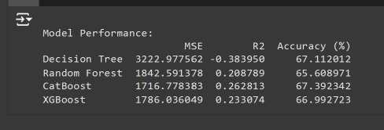
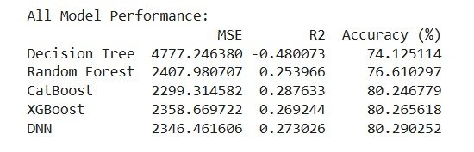
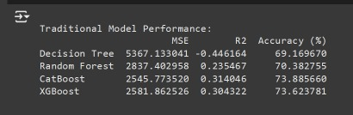
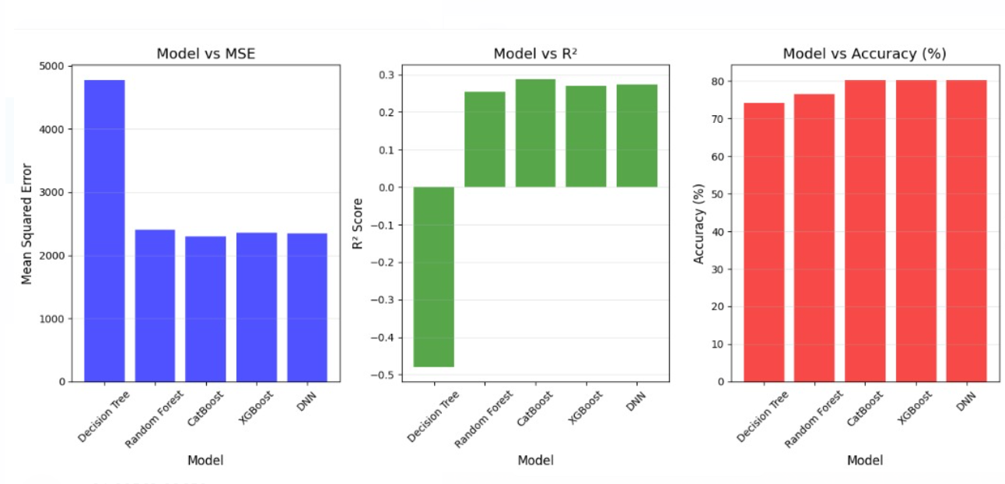
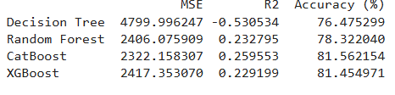
Results and Discussion

Slide 6
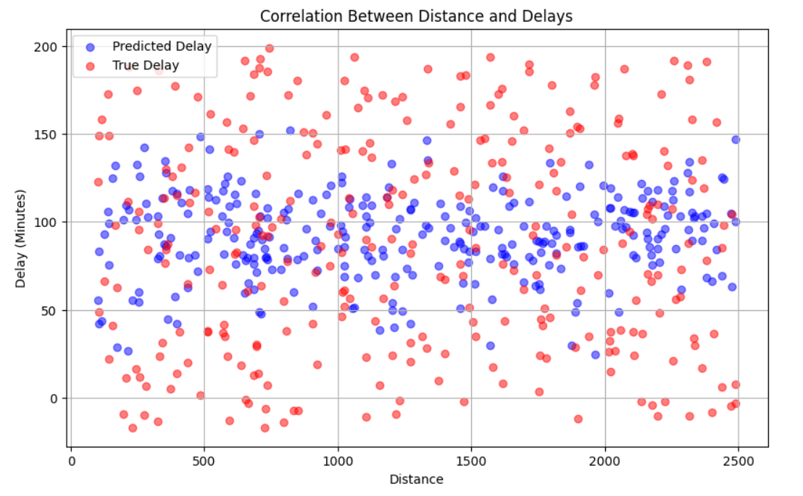
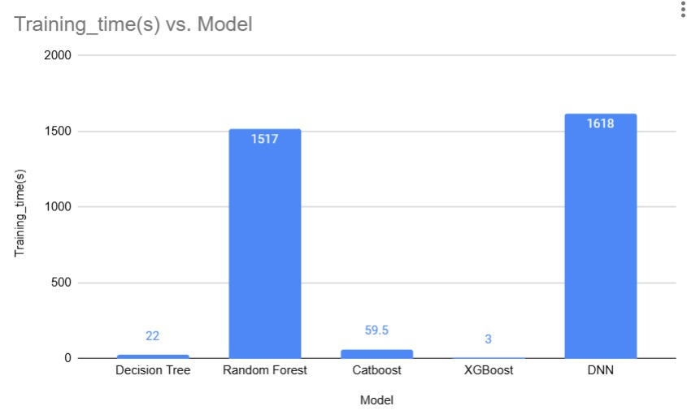
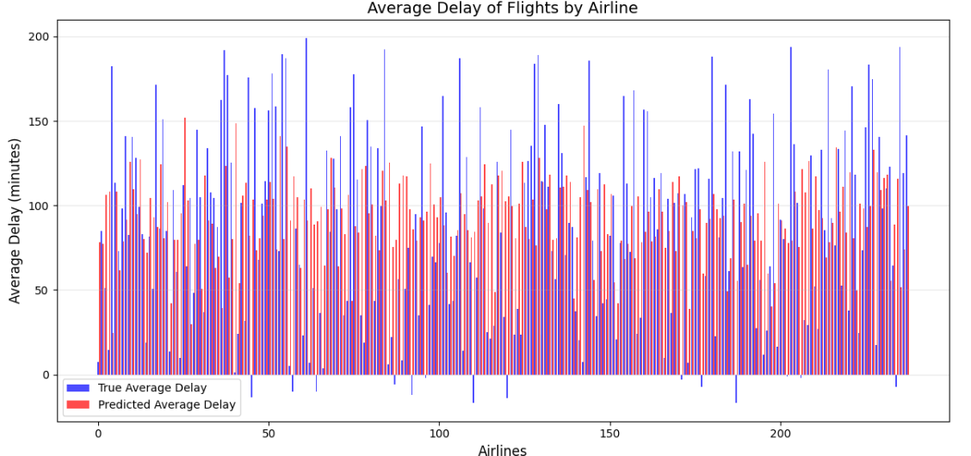
Results and Discussion

Slide 7
ML Ops Pipeline Strategy
Create a REST API end point to load the model and predict the delay.
FAST API and uvicorn python webserver to deploy.
Created a docker image with model dump to run the above REST end point and pushed the image onto the container.
Cron job is created to automate the whole process of creating the model dump, push it to docker image onto container.
Access the end point via Postman UI

Slide 8
Contribution
 | Rutvi | Balaji | Praveen | Malhar | Kushagra
Data cleanup and acquisition | 60 | 10 | 10 | 10 | 10
ML Model Selection/ Training | 20 | 20 | 20 | 20 | 20
Hyper parameter tuning | 10 | 30 | 10 | 40 | 10
Metrics | 15 | 20 | 10 | 15 | 40
MLOps | 0 | 0 | 100 | 0 | 0
Presentation - | 35 | 10 | 10 | 10 | 35
Documentation - | 40 | 15 | 15 | 15 | 15

Slide 9
Conclusion
Improved Decision-Making: The project successfully demonstrates how machine learning and deep learning can predict flight delays, aiding airlines, passengers, and air traffic controllers.
Robust Methodology: By processing over a million rows of raw data and leveraging advanced techniques like CAT Boost, the solution ensures accurate predictions and real-world applicability.
Operational Readiness: Deployment via a containerized REST API ensures scalability, and automation with tools like Docker and Python cron jobs enhances efficiency.
Significant Outcomes: Feature engineering and novel predictive features improved model performance, setting a benchmark for future predictive analytics in aviation.
Future Scope: Expanding the model to incorporate real-time data streams and additional variables like passenger load can further refine predictions.

Slide 10
References
[1] Navoneel Chakrabarty, Tuhin Kundu, Sudipta Dandapat, Apurba Sarkar, and Dipak Kumar Kole. Flight arrival delay prediction using gradient boosting classifier. InEmerging Technologies in Data Mining and Information Security, pages 651–659. Springer, 2019.
[2] Samprit Chatterjee and Ali S Hadi.Regression analysis by example. John Wiley & Sons, 2015
[3] Yi Ding. Predicting flight delay based on multiple linear regression. InIOP Conference Series: Earth and
Environmental Science, volume 81, page 012198. IOP Publishing, 2017.
[4] Suvojit Manna, Sanket Biswas, Riyanka Kundu, Somnath Rakshit, Priti Gupta, and Subhas Barman. A statistical approach to predict flight delay using gradient boosted decision tree. In2017 International Conference on Computational Intelligence in Data Science (ICCIDS), pages 1–5. IEEE, 2017
[5] Brett Naul. Airline departure delay prediction
[6] Jianmo Ni, Xinyuan Wang, and Ziliang Li. Flight delay prediction using temporal and geographical information.

